Slide 1
Line follower robot without Microcontroller

Slide 2
Group Members
Dwij Sukeshkumar Sheth
Yash Jain
Prakhar S Mathur
Aditya Kshettri

Slide 3
Line follower is an autonomous robot which follows either black line in white area or white line in black area. Robot must be able to detect particular line and keep following it.
For special situations such as cross over’s where robot can have more than one path which can be followed, predefined path must be followed by the robot.
Line following is a task in which robot has to follow the line. It must be capable of taking various degrees of turns to follow the curved lines also.

Slide 4
The Line following Robot moves to follow a line drawn on the floor. This Robot follows the black line which is drawn over the white surface .The line sensors are used to sense the line. When the signal falls on the white surface, it gets reflected and if it falls on the black surface, it is not reflected this principle is used to scan the Lines for the Robot.
The Robot should be capable of taking various degrees of turns and must be insensitive to environmental factors such as lighting and noise.

Slide 5
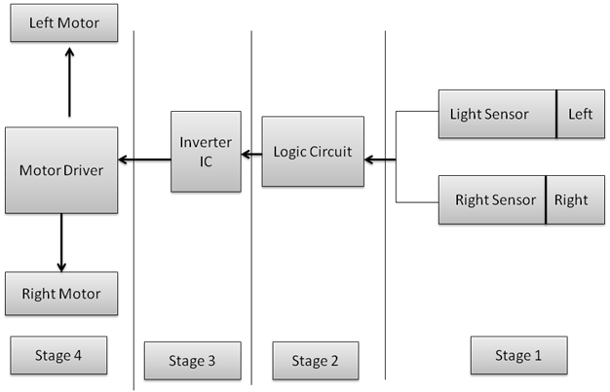

Slide 6
Parts Used
Voltage regulators
LDR
LED
L29D3 IC Section
Motors
Potentiometers
Resistors
LM324
HD74LS04 inverting IC

Slide 7
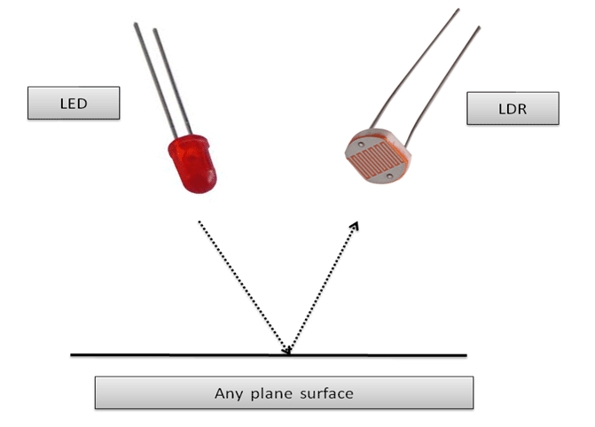
How will we detect the line?

Slide 8
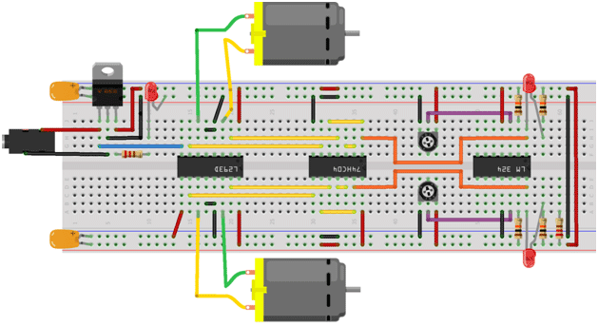

Slide 9
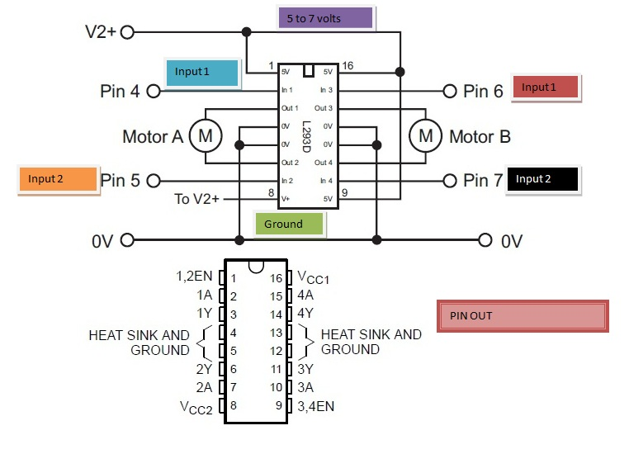
Pin Diagram of L293D

Slide 10
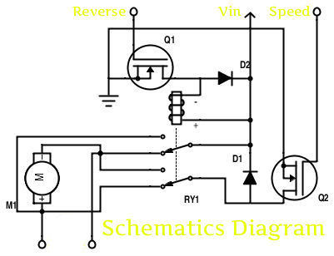
H-BRIDGE FOR SPEED CONTROL OF MOTORS

Slide 11
So, Two such modules are inbuilt in the ic L293D which can help in driving the circuit of the motors

Slide 12
CIRCUIT DIAGRAM/Schematic
We have split up the schematic and its explanation into parts as described .

Slide 13
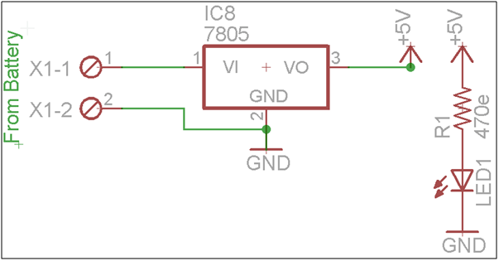
Power Supply Schematics

Slide 14
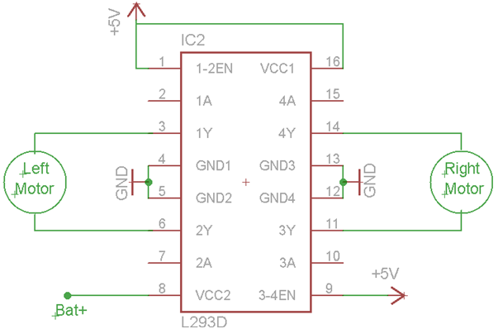
Motor Drive Section

Slide 15
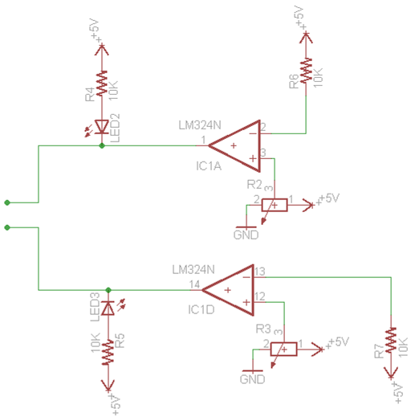
Logic Circuit for line detection

Slide 16
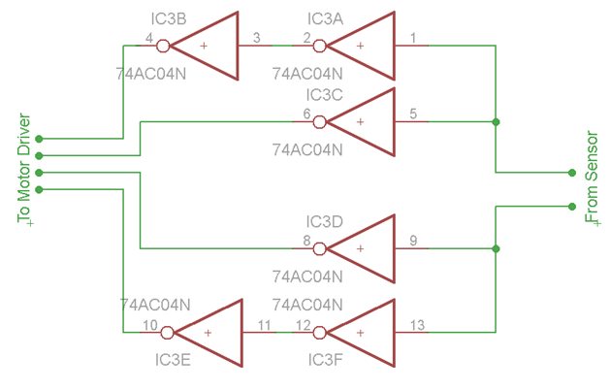
When we are detecting black line on a white surface we need to reverse the logic according to which the motor moves so for that we need the following inverting circuit

Slide 17
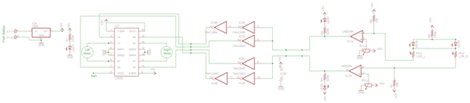
When we assemble the complete circuit together it will look like this
Power Section
Motor Drive Section
Logic Inverting Section
Logic and line detection Sensor circuit

Slide 18
Applications
Industrial Applications: These robots can be used as automated equipment carriers in industries replacing traditional conveyer belts.
Automobile applications: These robots can also be used as automatic cars running on roads with embedded magnets.
Domestic applications: These can also be used at homes for domestic purposes like floor cleaning etc.
Guidance applications: These can be used in public places like shopping malls, museums etc to provide path guidance.

Slide 19
Thank You

